Slide 1
Philosophy
On the following slide(s) you will see activities and the estimated / expected time that the student should spend on that activity.
It is important to note that the goal of the activities is to become familiar with the methods, ideas and implementation involved in that activity so that we can efficiently iron out all the details in live session.
Analogy: You are building the pieces of puzzle in the For Live Session Activity and we are putting them together to see the big picture in live session.
It is not expected that the student have all the correct answers. The expectation is that each student spend the allotted time (indicated next to the activity) on each activity so that we can discuss the details in live session.
If you max out the indicated time without finishing the activity and you don’t have more time to finish, simply write up what you have learned by that time and record any questions you might have and we will address those in live session!
We want to develop the questions before live session so that we can use the live session time to effectively answer them!

Slide 2
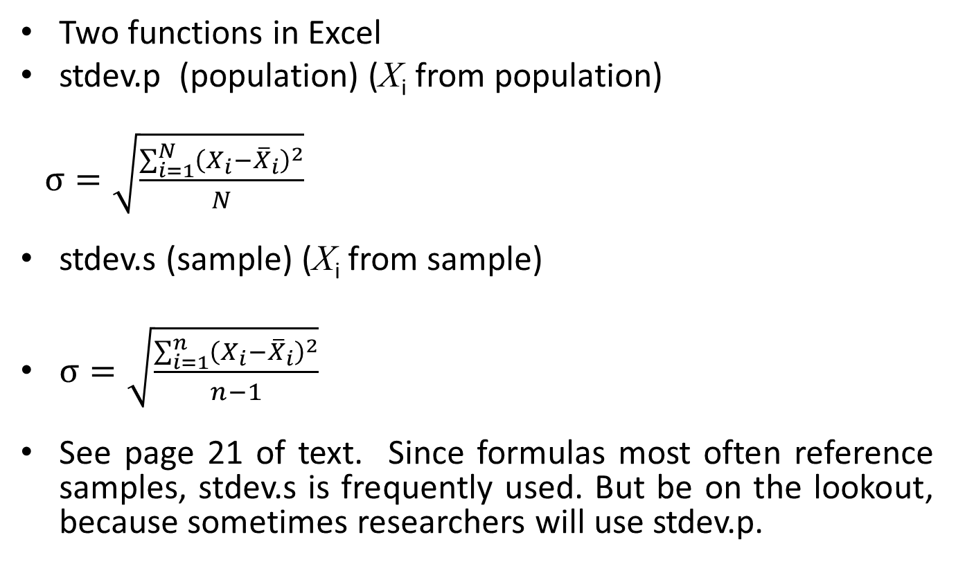
Calculating Standard Deviation
Two functions in Excel
stdev.p (population) (X_{i} from population)
$σ=\sqrt{\frac{\sum_{i=1}^{N}{{\left(X_{i}−{\overline{X}}_{i}\right)}^{2}}}{N}}$
stdev.s (sample) (X_{i} from sample)
$σ=\sqrt{\frac{\sum_{i=1}^{n}{{\left(X_{i}−{\overline{X}}_{i}\right)}^{2}}}{n−1}}$
See page 21 of text. Since formulas most often reference samples, stdev.s is frequently used. But be on the lookout, because sometimes researchers will use stdev.p.

Slide 3
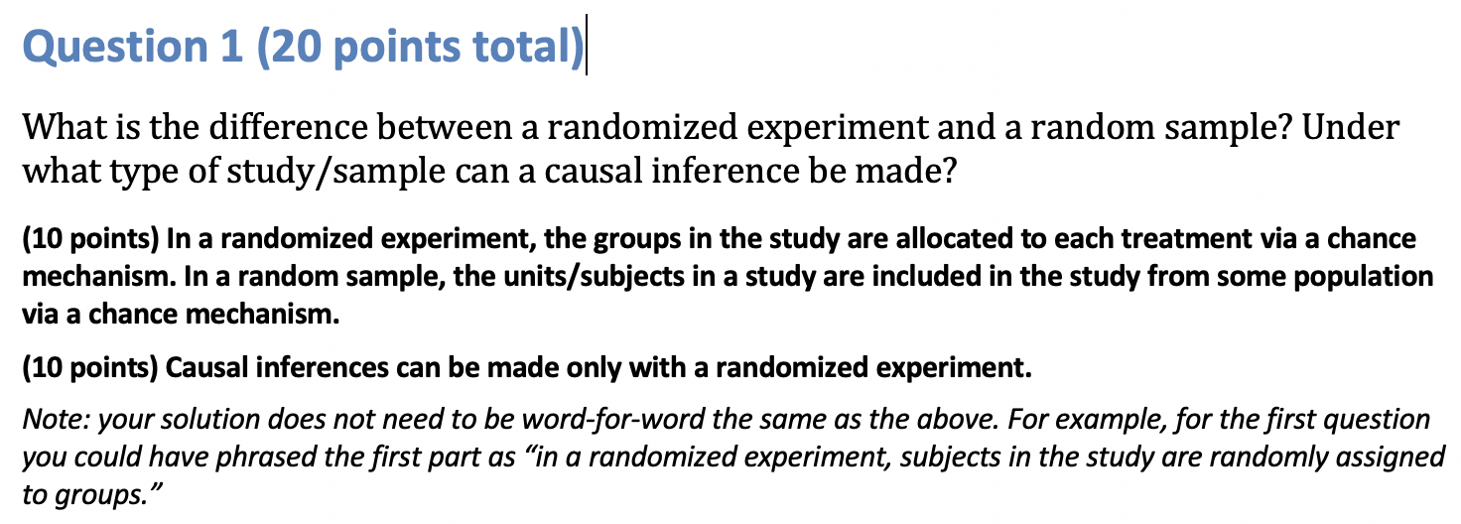
Question 1: A Solution

Slide 4
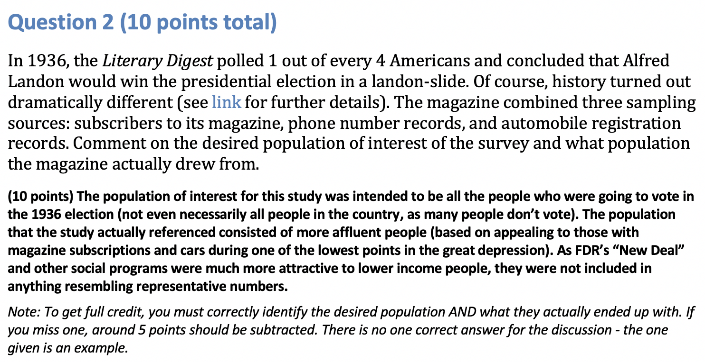
Question 2: A Solution

Slide 5
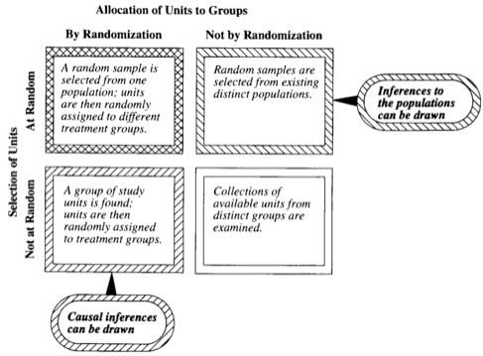
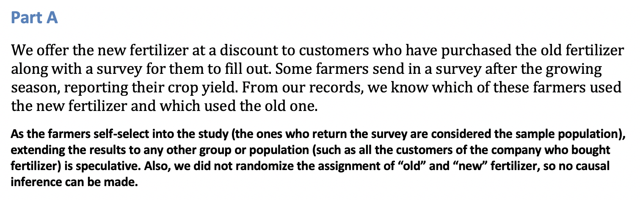
Question 3A: Solution
Suppose we have developed a new fertilizer that is supposed to help corn yields. This fertilizer is so potent that a small vial of it sprayed over an entire field is a sufficient dose. We find that the new fertilizer results in an average yield of 60 more bushels over the old fertilizer with a p-value of 0.0001. Write up a scope of inference under the following study designs that generated this data.

Slide 6
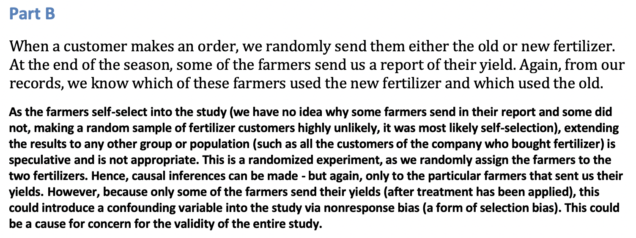
Question 3B: Solution
Suppose we have developed a new fertilizer that is supposed to help corn yields. This fertilizer is so potent that a small vial of it sprayed over an entire field is a sufficient dose. We find that the new fertilizer results in an average yield of 60 more bushels over the old fertilizer with a p-value of 0.0001. Write up a scope of inference under the following study designs that generated this data.

Slide 7
Question / Activity 4 (2-3 hours)
With respect the Creativity Study you read in the Statistical Sleuth, use the code provided (session1.sas) to conduct a permutation test to test for a difference in mean score between those motivated intrinsically and extrinsically. See Section 1.3 and 1.4 of the text to review the permutation test.
What is the difference in means between the groups in the samples?
How many iterations did the program run – note the macro variable setting at the top of the program?
Explain how the last table output is generated and interpret the result.
Why can you get different results by running the program again and/or changing the number of iterations? Try it and see what happens.

Slide 8
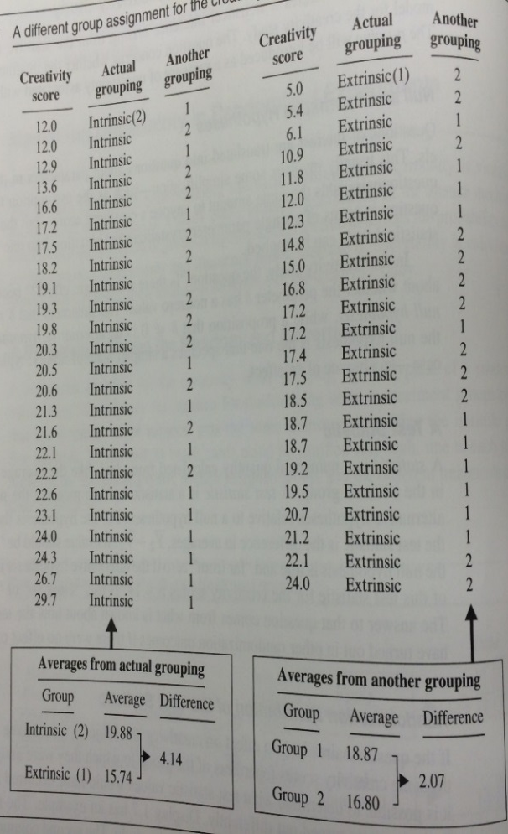
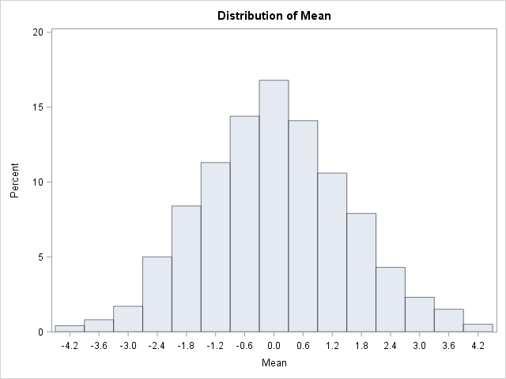

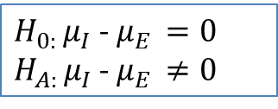
Question / Activity 4 Creativity Study: Testing the Hypothesis
Number of random regroupings:
1.6 x 10¹³
$H_{0: }μ_{I}$ - $μ_{E }=0$
$H_{A: }μ_{I}$ - $μ_{E }≠0$
1000 different groupings (relabelings)*
Half a year with a computer that can perform a million calculations per second!
$${\overline{Y}}_{I}−{\overline{Y}}_{E}$$
*Everyone has the same score with each grouping. What group each person is artificially put in changes with each regrouping. If the treatments had the same effect, then each participant would have the same score regardless of grouping.

Slide 9
Question / Activity 4 (2-3 hours)
What is the difference in means between the groups in the samples?
Display 1.7 – see p. 12 of the text and the first output table
How many iterations did the program run – note the macro variable setting at the top of the program?
1000 iterations were run. This can be changed by changing the macro variable.
Explain how the last table output is generated and interpret the result.
The program randomly assigns subjects in both groups to each of the groups and then calculates a mean difference for the groups. This process is done 1000 times to generate a distribution for the difference in sample averages. The number of times the absolute mean difference from the original data is greater than that generated randomly is divided by the number of iterations to give a test statistic. Since the test statistic is small we conclude there is an average difference in the scores in the population groups.
Why can you get different results by running the program again and/or changing the number of iterations? Try it and see what happens.
This is because the assignment to groups at each iteration is random so that assignment to groups changes at each iteration and the mean difference varies. Also, we are not running all possible permutations.

Slide 10
Question 5: Takeaways and Questions!
Please provide at least 4 takeaways from this section and any questions that you may have. These questions will help design the live session for this unit.
This question will be the last question of every For Live Session Assignment. The idea is that this deck will serve as a document that you can reference in the future to remember what was covered in this section. For instance, this may come in handy for the Capstone and will hopefully become useful in your career. Most immediately, it may become handy as a quick reference for your Midterm and Final! Some students find it very useful and spend a few slides summarizing the asynch material while others learn different ways and only had the minimum 4 takeaways. Either is fine and will earn you full credit for this question.

